Slide 1
Ulinkers
Acceptance Presentation
Teh Kaixin
Nabilah Banu
Sean Kwok
Nicole Goh
Chien Shu Yan
Notes:
1. Introduction of team, problem and solution. (10 mins)
2. Demo (15 mins)
3. Project plan (10 mins) <- top 3 risks
4. X factor and learning outcome (5 mins)

Slide 2

Agenda
Introduction
Problem and Solution
Project Development
Project Management
User Testing
Learning Outcomes

Slide 3



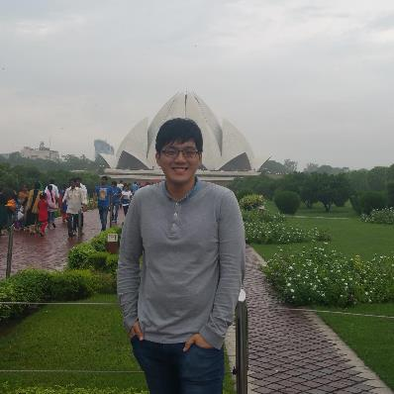
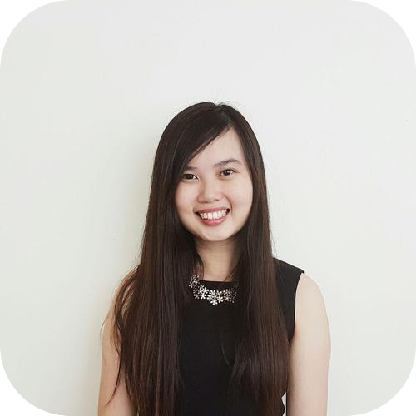
Team Members
Ulinkers
Nicole Goh
Teh Kaixin
Nabilah Banu
Lead Frontend Developer
Project Manager
Deputy Quality Assurance
Business Analyst
Deputy Backend Developer
Sean Kwok
Chien Shu Yan
Lead Backend Developer
Lead Quality Assurance
Deputy Frontend Developer

Slide 4

Operating since 1996
Medical concierge provider
Clinic and hospitalisation arrangements
Treatment plans and price estimates
Travel arrangements and visas
Standby assistance in Singapore
Most patients based in or visitors to Indonesia, Malaysia, Cambodia, Vietnam, Myanmar and China.
Makes more than 1000 appointments every year
Our Sponsor
Linda Siow, Executive

Slide 5
PROBLEM
Unable to keep track of teams’ performances
Lack of a timeline function to input research for recommended screenings
Views are not optimised
Client’s records are duplicated
Difficult to determine most number of referral, doctors, specialty

Slide 6

Solution
Clinic Management System
Analytical tools for decision making
(Specific KPI of different teams, Gender and Age, Top-k referral, doctor, specialty)
1
2
Timeline function for recommended screenings
3
Reduce redundant duplicates of clients’ data and information
Optimised views
(reduce duplicates, group by client name)
4

Slide 7
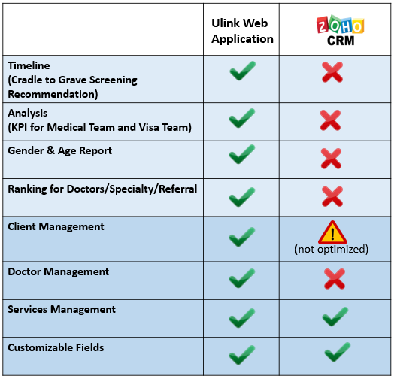
Market Research

Slide 8


DEMONSTRATION

Slide 9
TECHNICAL
ARCHITECTURE DIAGRAM

Slide 10
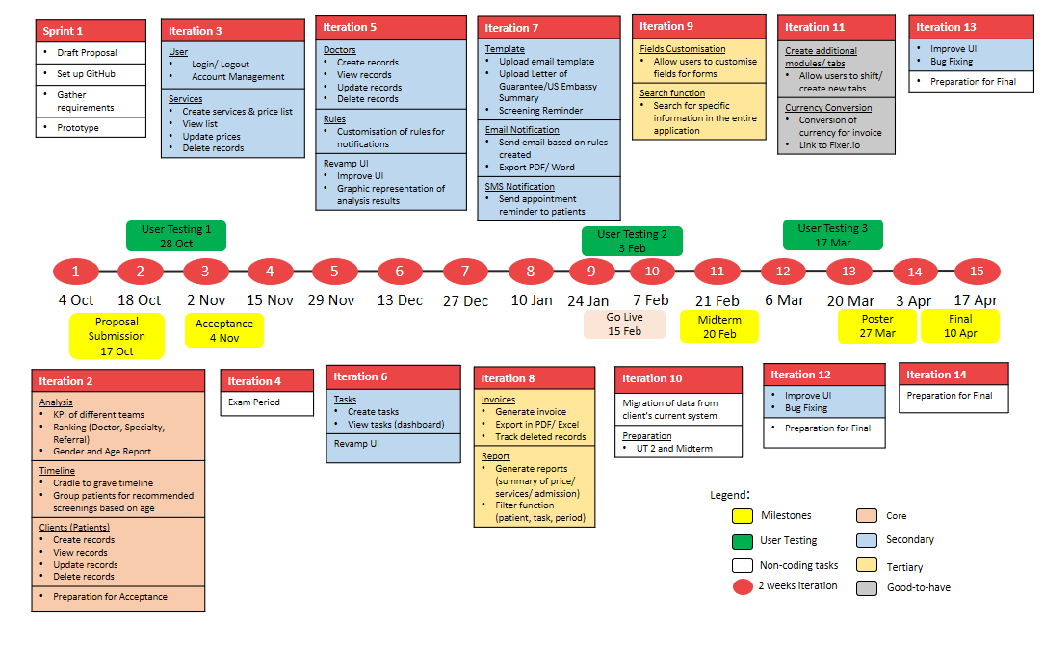

Project Management
Schedule

Slide 11
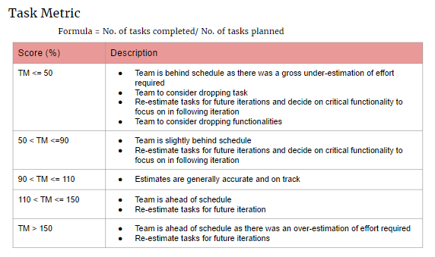
Project Management
Task Metric

Slide 12
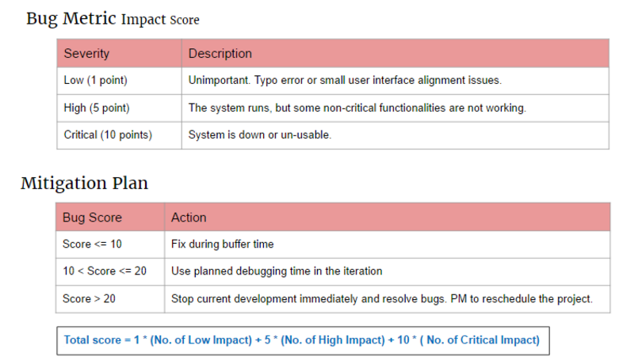
Project Management
Bug Metric

Slide 13
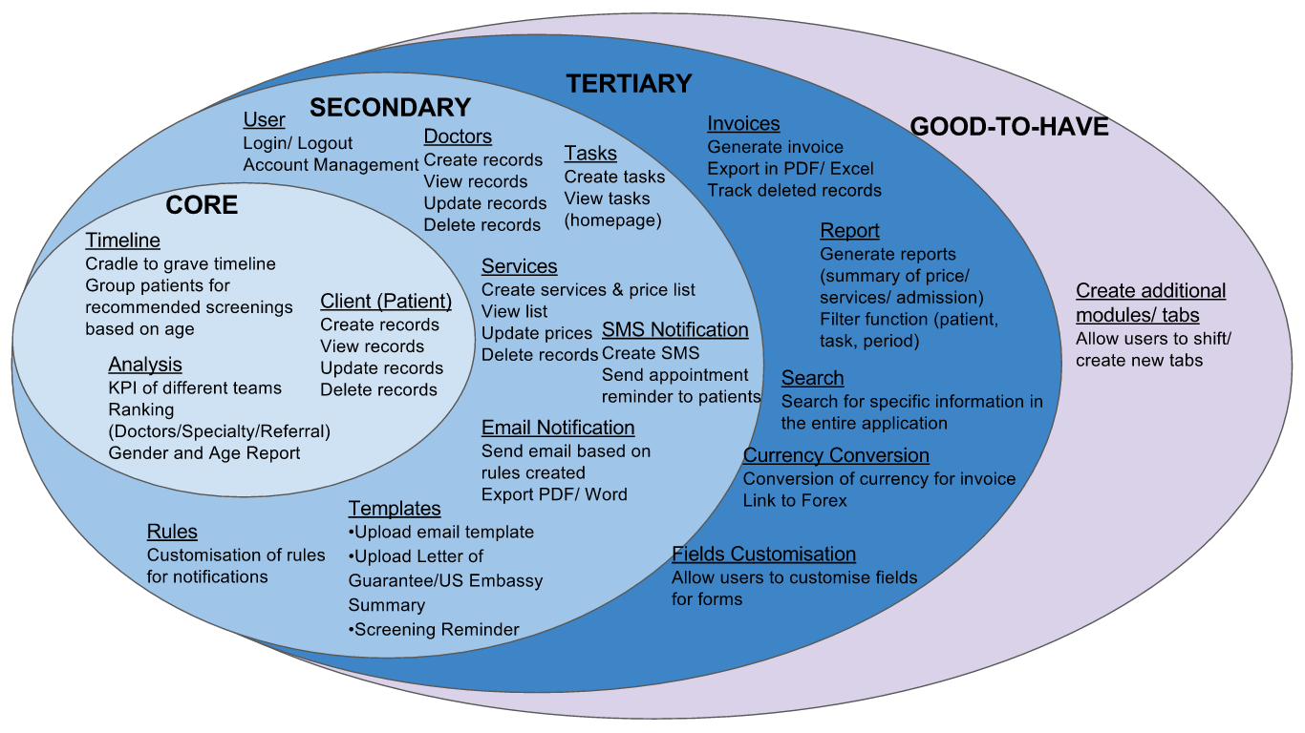
Project Development
Scope

Slide 14
User Testing 1
Ulink Assist Pte Ltd
1 User
Usability of UI
OCTOBER
28

Slide 15
UT 1 Feedback
Client prefers to choose which patient to send email to instead of automated sending of email
Analysis results to be in numbers

Slide 16
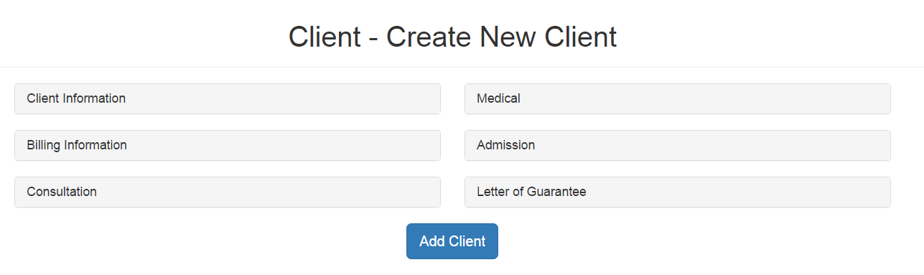
UT 1 Feedback
Display all fields for Client and Billing information in Client creation form

Slide 17
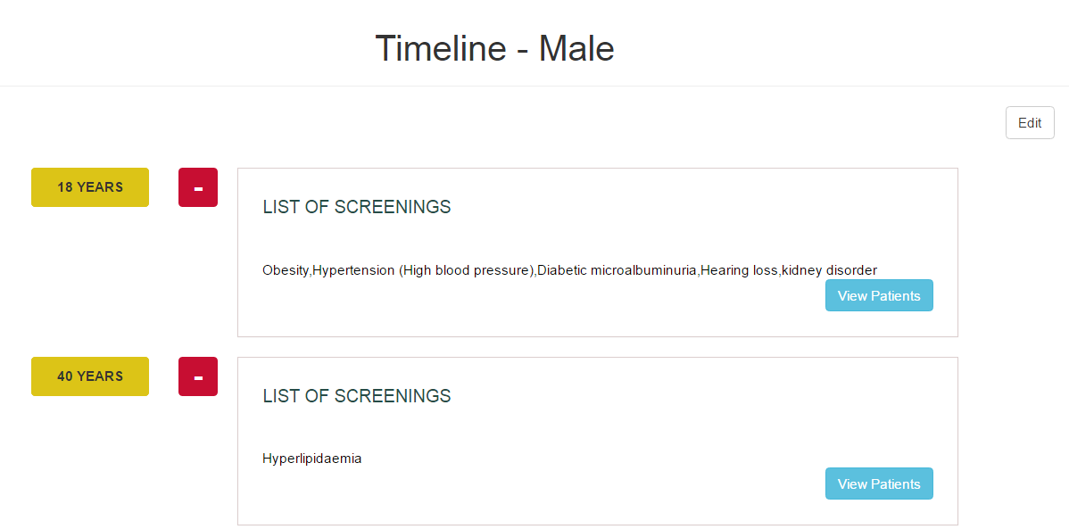
UT 1 Feedback
Timeline display is not intuitive, user suggested to change to table format
Client prefers to choose which patient to send email to instead of automated sending of email

Slide 18
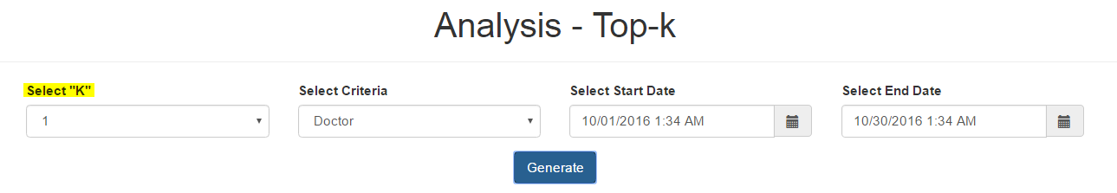
UT 1 Feedback
Top-K function to rename as "Ranking" for easy understanding
Remove “Select “K”” field and just display information in a table

Slide 19
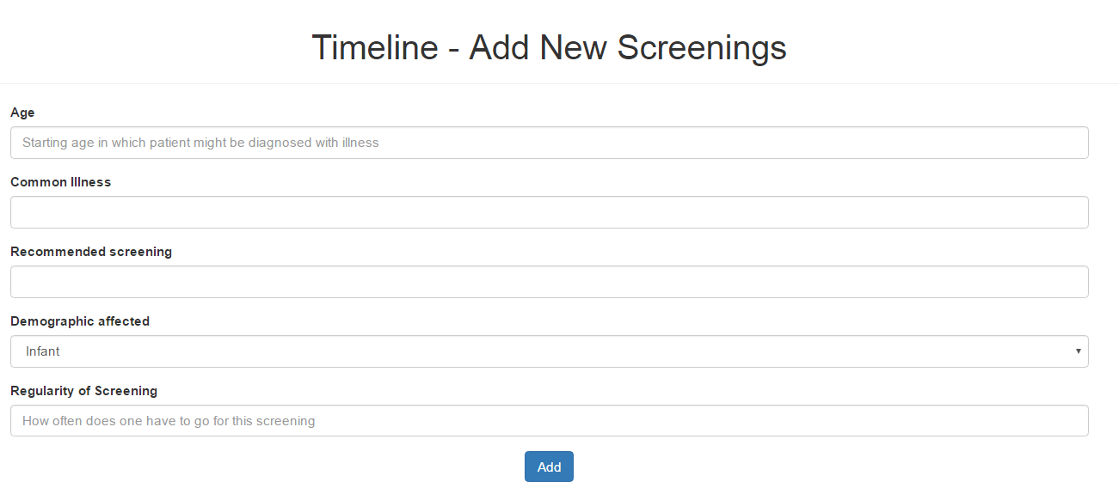
UT 1 Feedback
Add New Screening form to include "(In Years)" in Regularity field for easy understanding

Slide 20
X-FACTOR
Analyse 2000 patient data and display with infographics
Create 50 appointments using Ulink Web Application

Slide 21
LEARNING OUTCOME
Shu yan
nicole
Learn to conduct UAT effectively to collect users feedback, analyse the feedback and devise solution catered to their needs
Gain more knowledge on UI development and improve communication skills
Sean
Have a better understanding on how technology can help my client have a better view of their business performance
Nabilah
Kaixin
Apply knowledge of design processes and knowledge
Manage team and schedule effectively to deliver product on time

Slide 22

Thank you

Slide 23
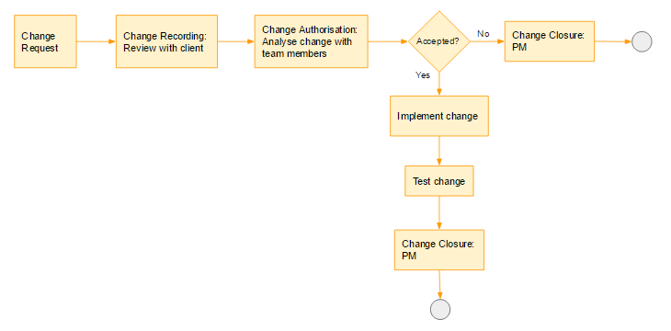
Project Management
Change Management

